Slide 1
Intel 8085 Microprocessor
Interfacing
1

Slide 2
Microprocessor
A microprocessor can perform some operation on a data and give the output.
But to perform the operation we need an input to enter the data and an output to display the results of the operation.
So we are using a keyboard and monitor as Input and output along with the processor.
Microprocessors engineering involves a lot of other concepts and we also interface memory elements like ROM, EPROM to access the
memory.
2

Slide 3
Contents
Salient features of 8085
Pin diagram of 8085
8085 Operations
Peripheral I/O instruction for Intel 8085 Microprocessor and its timing diagram
Interfacing with LED and seven segment display
8080A interrupts
RST instructions

Slide 4
Salient Features of 8085
It is a 8 bit microprocessor.
It is manufactured with N-MOS technology.
It has 16-bit address bus and hence can address up to 2¹⁶ = 65536 bytes (64KB) memory locations through A0-A15.
The first 8 lines of address bus and 8 lines of data bus are multiplexed AD0 – AD7.
Data bus is a group of 8 lines D0 – D7.

Slide 5
Salient Features of 8085 (Cont.)
It supports external interrupt request.
A 16 bit program counter (PC) A 16 bit stack pointer (SP)
Six 8-bit general purpose register arranged in pairs: BC, DE, HL.
It requires a signal +5V power supply and operates at 3.2 MHZ single phase clock.
It is enclosed with 40 pins DIP (Dual in line package).

Slide 6
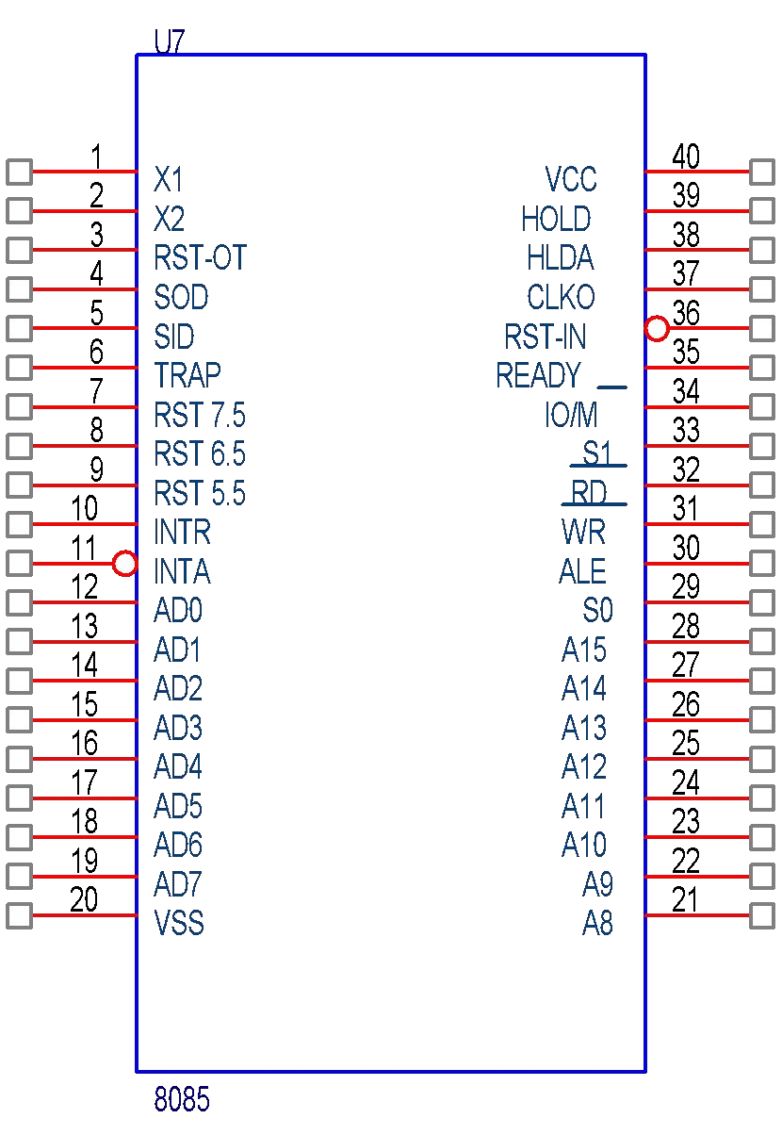
Pinout Diagram of 8085
A 40-pin IC
Six groups of signals
Address Bus
Data Bus
Control and Status pins
Power Supply & frequency signals
Externally initiated Signals
Serial I/O ports

Slide 7
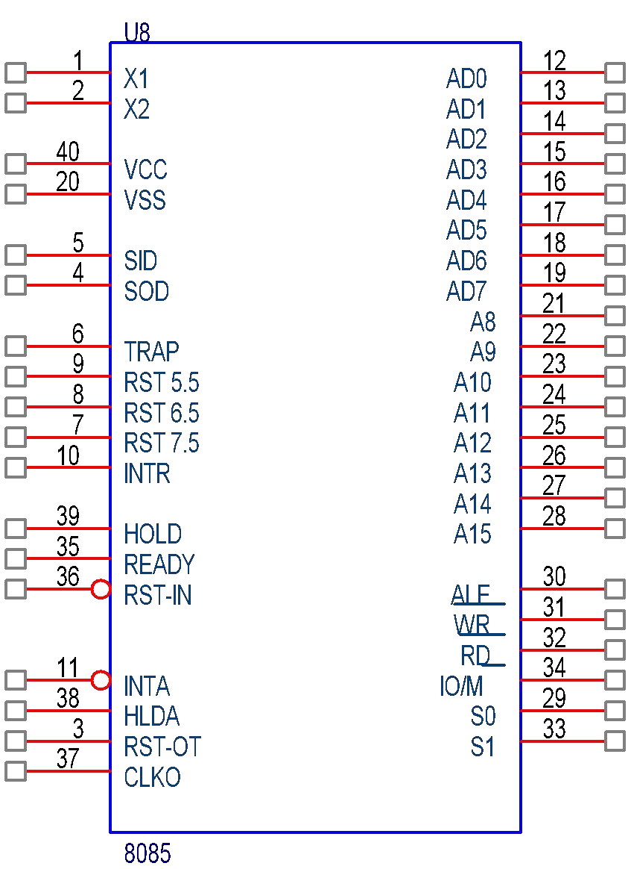
Logic Pinout of 8085
Power Supply & frequency
Serial I/O ports
Externally initiated signals
Data Bus
Address Bus
Control & Status
Control & Status

Slide 8
8085 Operations
Microprocessor Initiated Operations
Internal Operations
Peripheral/Externally Initiated Operations

Slide 9
Microprocessor Initiated Operations
Memory Read
Memory Write
I/O Read
I/O Write

Slide 10
Internal Operations
Store 8-bit data
Perform Arithmetic and Logic Operations
Test for conditions
Sequence the execution of instructions
Store/Retrieve data from stack during execution

Slide 11
Peripheral/Externally Initiated Operations
Reset
Interrupt
Ready
Hold

Slide 12

Interfacing I/O devices with 8085
I/O Interface
I/O Devices
8085
System Bus
Memory Interface
Memory Devices

Slide 13
Techniques for I/O Interfacing
Memory-mapped I/O
Peripheral-mapped I/O

Slide 14
Memory-mapped I/O
8085 uses its 16-bit address bus to identify a memory location
Memory address space: 0000H to FFFFH
8085 needs to identify I/O devices also
I/O devices can be interfaced using addresses from memory space
8085 treats such an I/O device as a memory location
This is called Memory-mapped I/O

Slide 15
Peripheral-mapped I/O
8085 has a separate 8-bit addressing scheme for I/O devices
I/O address space: 00H to FFH
This is called Peripheral-mapped I/O or I/O-mapped I/O

Slide 16
8085 Communication with I/O devices
Involves the following three steps
Identify the I/O device (with address)
Generate Timing & Control signals
Data transfer takes place
8085 communicates with a I/O device only if there is a Program Instruction to do so

Slide 17
1.Identify the I/O device (with address)
Memory-mapped I/O (16-bit address)
Peripheral-mapped I/O (8-bit address)

Slide 18
2.Generate Timing & Control Signals
Memory-mapped I/O
Reading Input: IO/M = 0, RD = 0
Write to Output: IO/M = 0, WR = 0
Peripheral-mapped I/O
Reading Input: IO/M = 1, RD = 0
Write to Output: IO/M = 1, WR = 0
3. Data transfer takes place

Slide 19
Peripheral I/O Instructions
IN Instruction
Inputs data from input device into the accumulator
It is a 2-byte instruction
Format: IN 8-bit port address
Example: IN 01H

Slide 20
OUT Instruction
Outputs the contents of accumulator to an output device
It is a 2-byte instruction
Format: OUT 8-bit port address
Example: OUT 02H

Slide 21
Memory-mapped I/O Instructions
I/O devices are identified by 16-bit addresses
8085 communicates with an I/O device as if it were one of the memory locations
Memory related instructions are used
For e.g. LDA, STA
LDA 8000H
Loads A with data read from input device with 16-bit address 8000H
STA 8001H
Stores (Outputs) contents of A to output device with 16-bit address 8001H

Slide 22
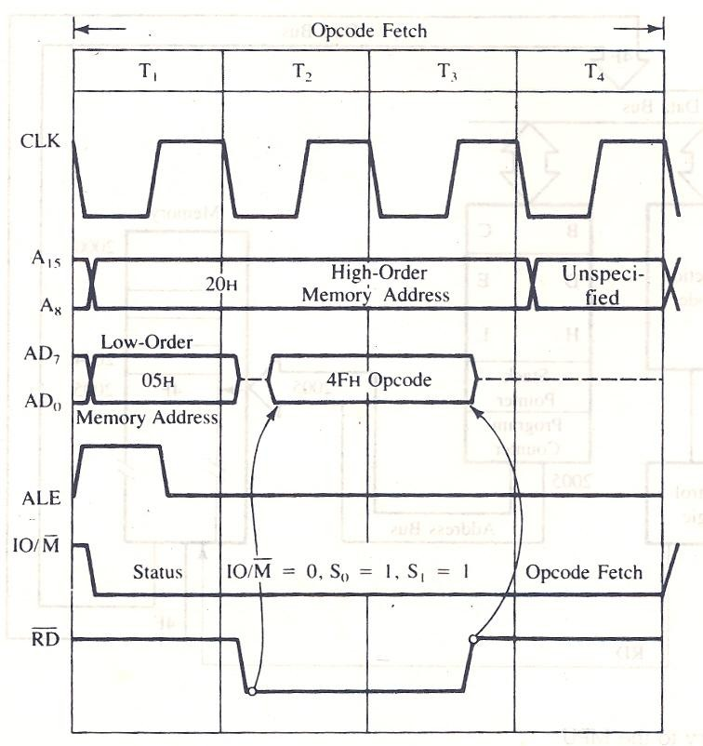
Timing Diagram

Slide 23
Interfacing with LED and seven segment display
An LED or Light Emitting Diode, is a solid state optical pn-junction diode which emits light energy in the form of photons.
the main advantage of light emitting diodes is that because of their small die size, several of them can be connected together within one small and compact package producing what is generally called a 7-segment Display.

Slide 24
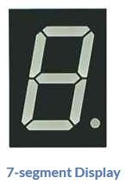
Cont…
The 7-segment display consists of seven LEDs (hence its name) arranged in a rectangular fashion as shown. Each of the seven LEDs is called a segment because when illuminated the segment forms part of a numerical digit (both Decimal and Hex) to be displayed.

Slide 25
There are two types of LED 7-segment display called: Common Cathode (CC) and Common Anode (CA).
1. The Common Cathode (CC) – In the common cathode display, all the cathode connections of the LED segments are joined together to logic “0” or ground. The individual segments are illuminated by application of a “HIGH”, or logic “1” signal via a current limiting resistor to forward bias the individual Anode terminals (a-g).

Slide 26
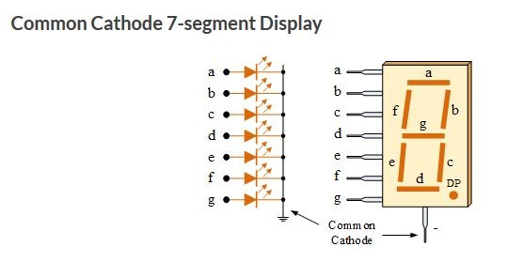

Slide 27
2. The Common Anode (CA) – In the common anode display, all the anode connections of the LED segments are joined together to logic “1”. The individual segments are illuminated by applying a ground, logic “0” or “LOW” signal via a suitable current limiting resistor to the Cathode of the particular segment (a-g).

Slide 28
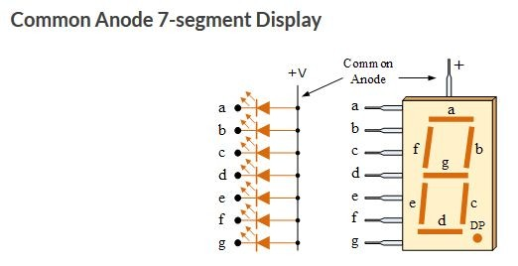

Slide 29
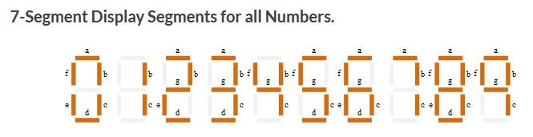

Slide 30
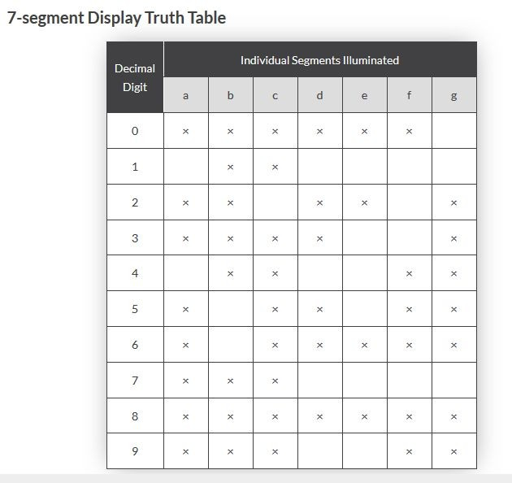

Slide 31
Interrupts
Interrupt is the method of creating a temporary halt during program execution and allows peripheral devices to access the microprocessor.
The microprocessor responds to that interrupt with an ISR (Interrupt Service Routine), which is a short program to instruct the microprocessor on how to handle the interrupt.
Interrupts can be internal or external.

Slide 32
8080A interrupts
There are five interrupt signals in the 8085 microprocessor:
TRAP: The TRAP interrupt is a non-maskable interrupt that is generated by an external device, such as a power failure or a hardware malfunction. The TRAP interrupt has the highest priority and cannot be disabled. (A 'Maskable Interrupt' in computer science refers to an interrupt mechanism that can be enabled or disabled by the programmer. It is contrasted with a 'Non-maskable Interrupt' which has a higher priority and cannot be disabled, typically used for critical events like power loss.)
RST 7.5: The RST 7.5 interrupt is a maskable interrupt that is generated by a software instruction. It has the second highest priority.
RST 6.5: The RST 6.5 interrupt is a maskable interrupt that is generated by a software instruction. It has the third highest priority.
RST 5.5: The RST 5.5 interrupt is a maskable interrupt that is generated by a software instruction. It has the fourth highest priority.
INTR: The INTR interrupt is a maskable interrupt that is generated by an external device, such as a keyboard or a mouse. It has the lowest priority and can be disabled.
32

Slide 33
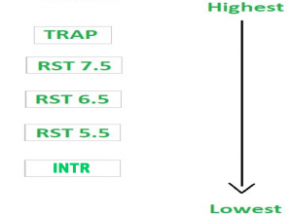
Priority of Interrupts – When microprocessor receives multiple interrupt requests simultaneously, it will execute the interrupt service request (ISR) according to the priority of the interrupts.
32

Slide 34
8080A interrupts
The processor has 5 interrupts. They are presented below in the order of their priority (from lowest to highest):
INTR is maskable 8080A compatible interrupt.
When the interrupt occurs the processor fetches from the bus one instruction, usually one of these instructions: One of the 8 RST instructions (RST⁰
- RST⁷).
The processor saves current program counter into stack and branches to memory location N * 8 (where N3-bit number from 0 to 7 supplied with
the RST instruction).
32

Slide 35
8080A interrupts (Cont.)
RST5.5 is a maskable interrupt.
When this interrupt is received the processor saves the contents of the PC register into stack and branches to 2CH (hexadecimal) address.
RST6.5 is a maskable interrupt.
When this interrupt is received the processor saves the contents of the PC register into stack and branches to 34H (hexadecimal) address.
33

Slide 36
8080A interrupts (Cont.)
RST7.5 is a maskable interrupt.
When this interrupt is received the processor saves the contents of the PC register into stack and branches to 3CH (hexadecimal) address.
TRAP is a non-maskable interrupt.
saves the contents of the PC register into stack and branches to 24H (hexadecimal) address.
All maskable interrupts RST 5.5, RST6.5 and RST7.5 interrupts can be enabled or disabled
individually using SIM instruction.
34

Slide 37
RST Instructions
In 8085 Instruction set, RSTn is actually standing for “Restart n”. And in this case, n has a value from 0 to 7 only.
Thus the eight possible RST instructions are there, e.g. RST 0, RST 1, …, RST 7.
They are 1-Byte call instructions. (A one-byte instruction includes a opcode and a operand in the same byte. Operand(s) are internal registers and are in the instruction in form of codes. If there is no numeral present in the instruction then that instruction will be of one-byte, for example, MOV C, A, RAL, and ADD B, etc.)
Functionally RST n instruction is similar with: RST n = CALL n*8

Slide 38
RST Instructions (Cont.)
For example, let us consider RST 4 is functionally equivalent to CALL 4*8, i.e. CALL 32 = CALL 0020H.
The advantage of RST 2 is that it is only 1 Byte, whereas CALL 0010H is 3-Byte long.
Thus RST instructions are useful for branching to frequently used subroutines.

